Slide 1
Spring Batch 프로젝트와 Quartz 스케줄러다. 전자는 batch process, 즉 순차적으로 진행되는 작업의 모음을 실행하고 분기에 따라 처리하며 후자는 timed job, 즉 cron 표현식이나 일정 시간마다 지정한 횟수만큼 반복해서 특정 작업을 실행할 수 있는 라이브러리다.
Quartz 를 사용하는 이유
작업실패 시 재시작 처리, 애플리케이션 재시작 후에 작업 복귀, JTA 트랜잭션 및 클러스터링 등 복잡한 기능 필요할때 수준높은 기능 제공
스프링 부트의 지원
스프링부트에서 Quartz 스케줄러에 대한 연동 제공
핵심구성요소
Job, JobDetail

Slide 2
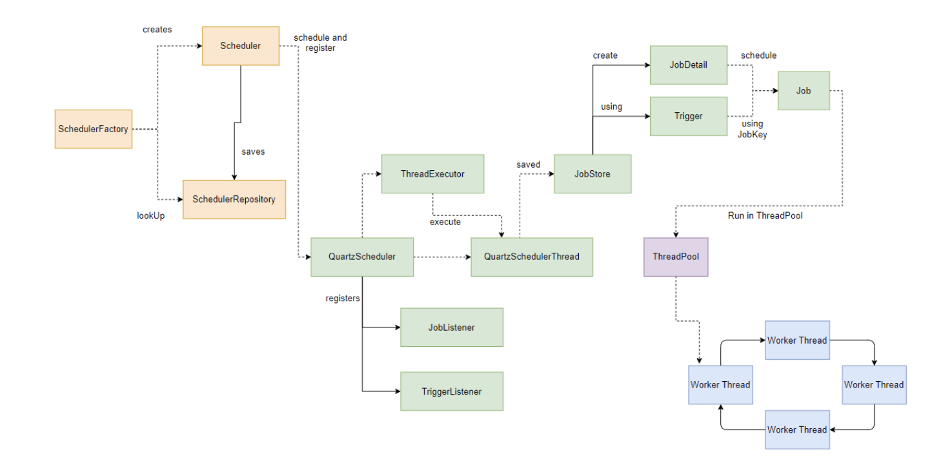
# Key Components of Quartz Scheduler Model
Scheduler Factory – The factory bean that is responsible for building the Scheduler model and wiring in all the dependent components, based on the contents of the quartz properties file.
Scheduler – Maintains the JobDetail/Trigger registry. It is also responsible for executing the associated jobs when a trigger fires.
Scheduler Thread – The thread responsible for performing the work of firing the triggers. It contacts the JobStore to get the next set of triggers to be fired.
Job – An interface that must be implemented by the task to be executed.
Trigger – Instructs the scheduler about the time that the associated job should be fired.
JobStore – An interface to be implemented by the classes that provide a storage mechanism for Jobs and Triggers.
ThreadPool – A job to be executed is transferred to the pool of threads, represented by the ThreadPool.
Worker Threads - Individual threads that build up the ThreadPool and execute jobs.
Notes:
https://stackabuse.com/guide-to-quartz-with-spring-boot-job-scheduling-and-automation/

Slide 3
Kafka docker 에 설치 후 spring boot 연동
Kafka-Docker install https://hub.docker.com/r/wurstmeister/kafka/
Eclipse 에서 kafka 연동 자바 프로젝트 생성. (pom.xml 파일 / application.yml 파일에 kafka 라이브러리 및 관련 정보 매핑 )
docker-compose.yml 파일 생성
Youngminui-iMac:scheduler-common youngminlee$ ls
docker-compose.yml src pom.xml target
Youngminui-iMac:scheduler-common youngminlee$ docker-compose up -d
Pulling kafka (wurstmeister/kafka:)...
latest: Pulling from wurstmeister/kafka
42c077c10790: Pull complete
44b062e78fd7: Pull complete
b3ba9647f279: Pull complete
10c9a58bd495: Pull complete
ed9bd501c190: Pull complete
03346d650161: Pull complete
539ec416bc55: Pull complete
Digest: sha256:2d4bbf9cc83d9854d36582987da5f939fb9255fb128d18e3cf2c6ad825a32751
Status: Downloaded newer image for wurstmeister/kafka:latest
Creating scheduler-common_kafka_1 ... done
Creating scheduler-common_zookeeper_1 ... Done
Youngminui-iMac:scheduler-common youngminlee$ docker ps
CONTAINER ID IMAGE COMMAND CREATED STATUS PORTS NAMES
197a4d026215 wurstmeister/kafka "start-kafka.sh" 9 seconds ago Up 7 seconds 0.0.0.0:9092->9092/tcp scheduler-common_kafka_1
98584af723a4 wurstmeister/zookeeper "/bin/sh -c '/usr/sb…" 9 seconds ago Up 7 seconds 22/tcp, 2888/tcp, 3888/tcp, 0.0.0.0:2181->2181/tcp scheduler-common_zookeeper_1

Slide 4
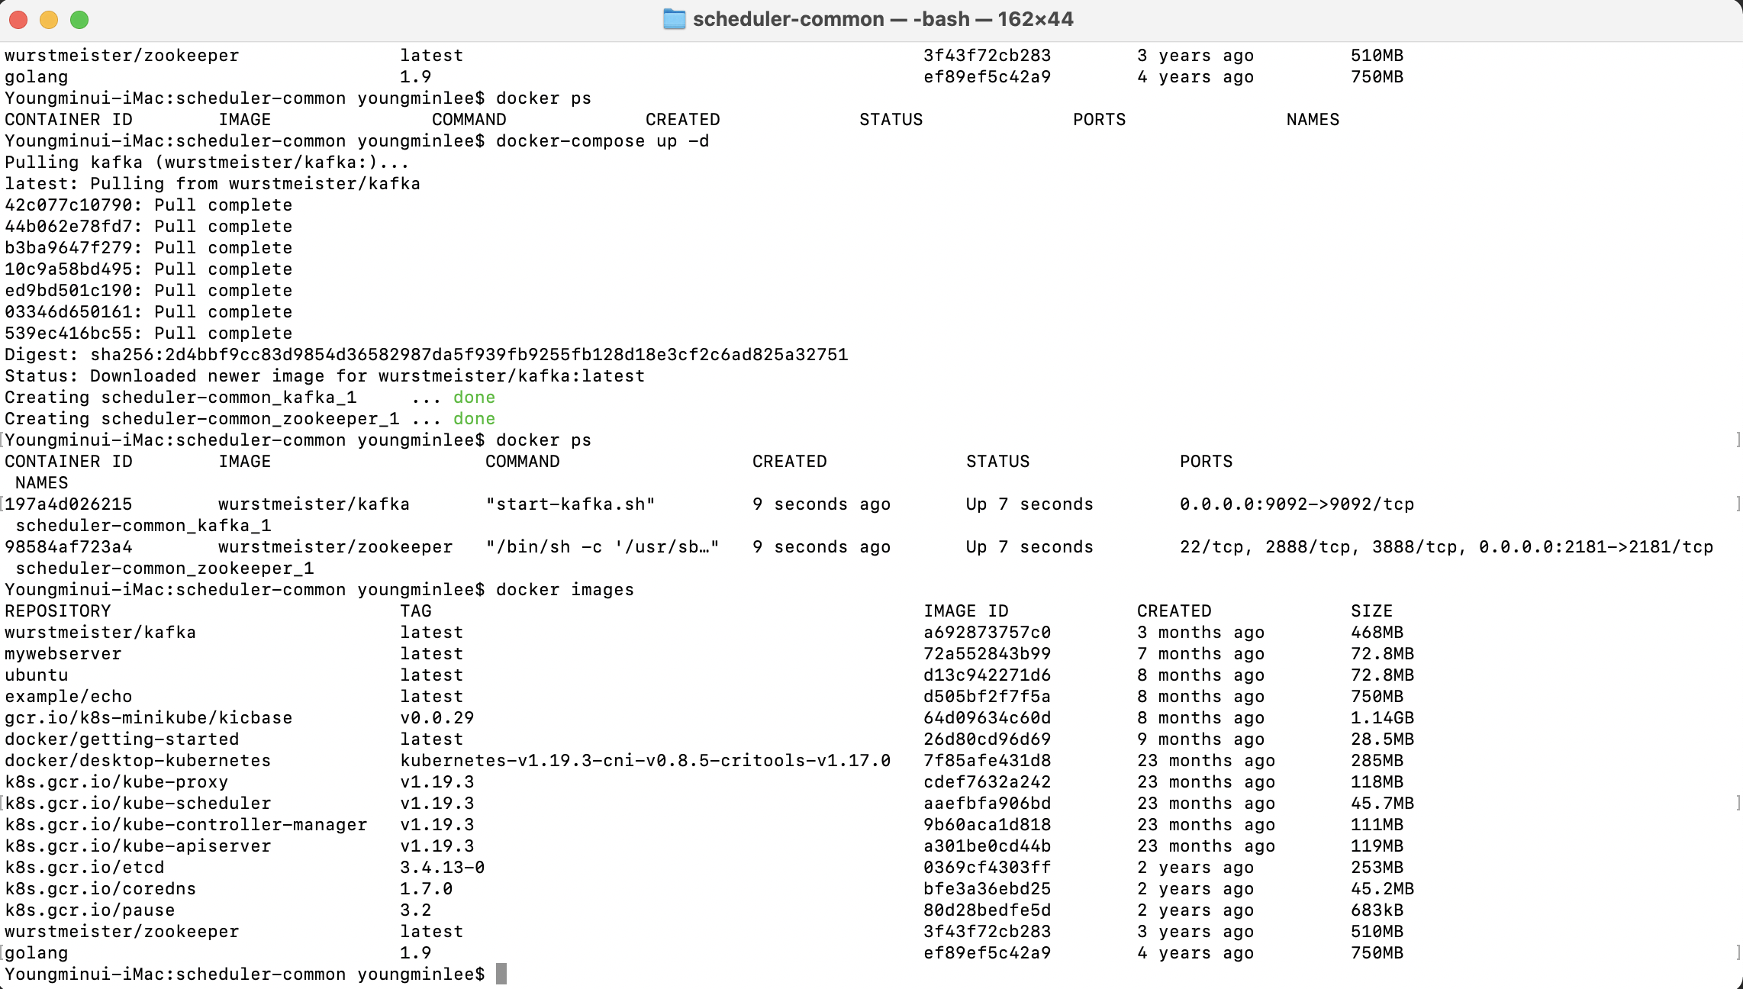

Slide 5
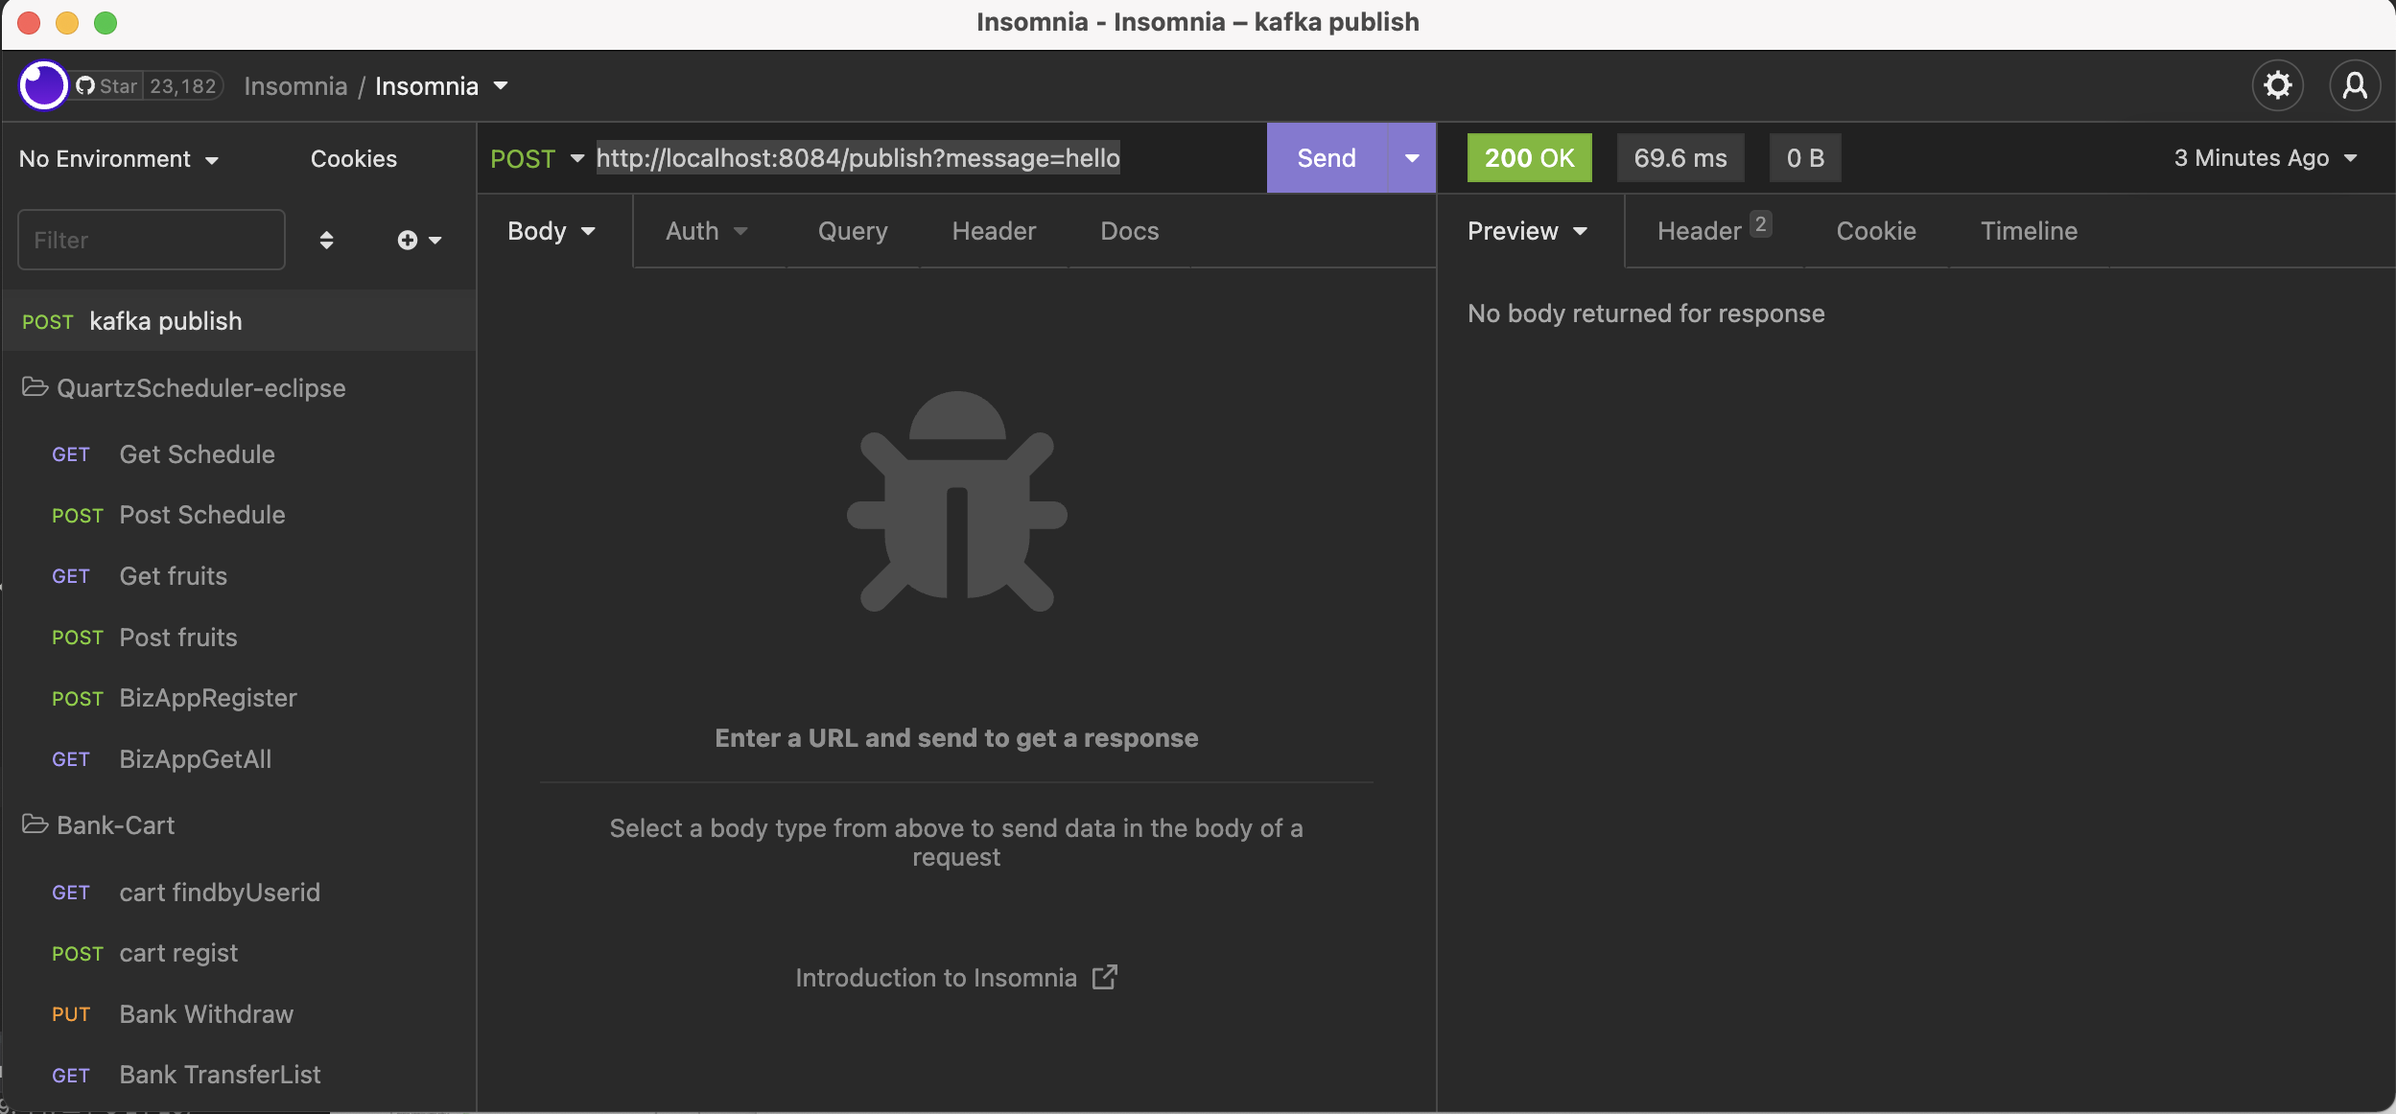
/** insomnia 에서 * http://localhost:8084/publish?message=hello 라고 입력하면
이클립스 콘솔에 >>> Received Message : hello 출력됨. */
2022-09-11 21:24:51.382 INFO 3437 --- [nio-8084-exec-3] o.a.k.clients.producer.KafkaProducer : [Producer clientId=producer-1] Instantiated an idempotent producer.
2022-09-11 21:24:51.396 INFO 3437 --- [nio-8084-exec-3] o.a.kafka.common.utils.AppInfoParser : Kafka version: 3.1.1
2022-09-11 21:24:51.398 INFO 3437 --- [nio-8084-exec-3] o.a.kafka.common.utils.AppInfoParser : Kafka commitId: 97671528ba54a138
2022-09-11 21:24:51.399 INFO 3437 --- [nio-8084-exec-3] o.a.kafka.common.utils.AppInfoParser : Kafka startTimeMs: 1662899091396
2022-09-11 21:24:51.404 INFO 3437 --- [ad | producer-1] org.apache.kafka.clients.Metadata : [Producer clientId=producer-1] Cluster ID: Gnz-MzftSGij0Q4DKveT0g
2022-09-11 21:24:51.407 INFO 3437 --- [ad | producer-1] o.a.k.c.p.internals.TransactionManager : [Producer clientId=producer-1] ProducerId set to 0 with epoch 0
2022-09-11 21:24:51.417 INFO 3437 --- [ad | producer-1] org.apache.kafka.clients.Metadata : [Producer clientId=producer-1] Resetting the last seen epoch of partition test_topic-0 to 0 since the associated topicId changed from null to __G9QDJQQAWlIuCqpTX0Dw
2022-09-11 21:24:51.417 INFO 3437 --- [ad | producer-1] org.apache.kafka.clients.Metadata : [Producer clientId=producer-1] Resetting the last seen epoch of partition test_topic-2 to 0 since the associated topicId changed from null to __G9QDJQQAWlIuCqpTX0Dw
2022-09-11 21:24:51.417 INFO 3437 --- [ad | producer-1] org.apache.kafka.clients.Metadata : [Producer clientId=producer-1] Resetting the last seen epoch of partition test_topic-1 to 0 since the associated topicId changed from null to __G9QDJQQAWlIuCqpTX0Dw
>>> Received Message : hello

Slide 6
Service port: 18084
Biz App #1
Port: 18081
Scheduler-common-service
(Kafka Pub/sub)
Service port: 18080
Port: 18082
Scheduler-app-service
(Web Console)
Biz App #2
Biz App #3
publish
Port: 18083
Service port: 18085
Scheduler-quartz-service
Docker
Maria DBMS
kafka port: 9092
Zookeeper port : 2181
DBMS : 3036
QUARTZ_XXX
Kafka topic
BizAppStore
Listen (subscription)
SchedulerJobInfo

Slide 7
